Slide 1
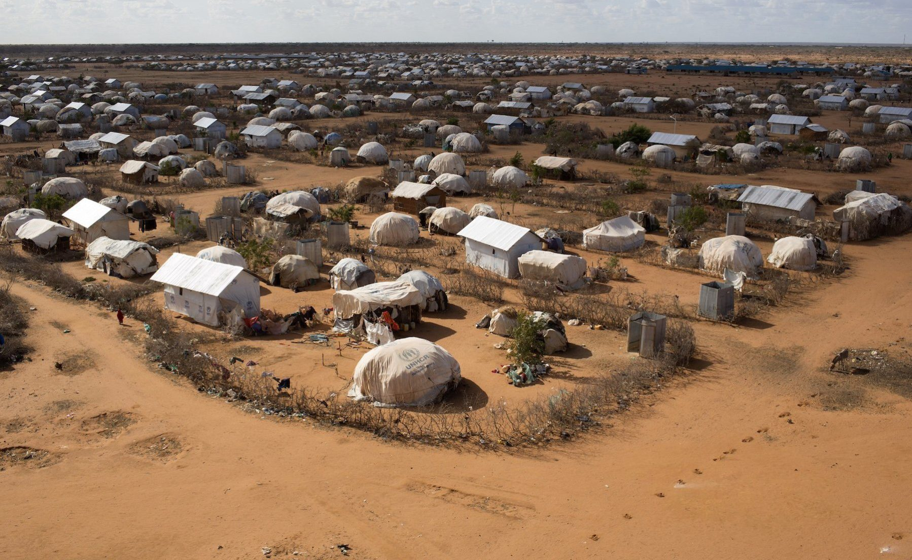
Investment Proposal for Social Justice and Democratic Values in Turkana County, Kenya
A Five-Year Strategic Plan (2024-2029)
The Good Council
Errikos Matevosian iis23018
16/08/2024

Slide 2
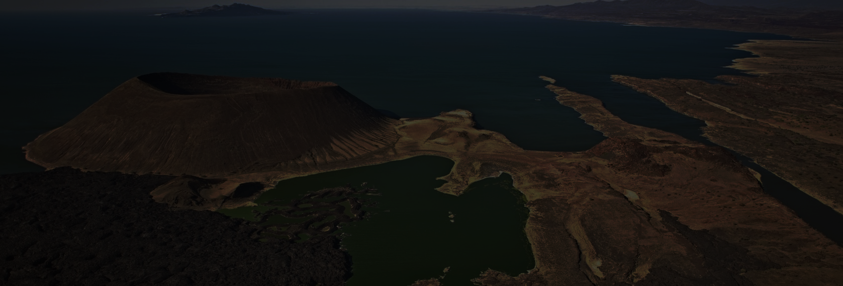
Mission Statement
Our mission is:
To empower the residents of Turkana County through targeted initiatives that improve education, healthcare, and civic engagement.
To foster social justice and strengthen democratic values in one of Kenya’s most marginalized regions.
The Good Council

Slide 3
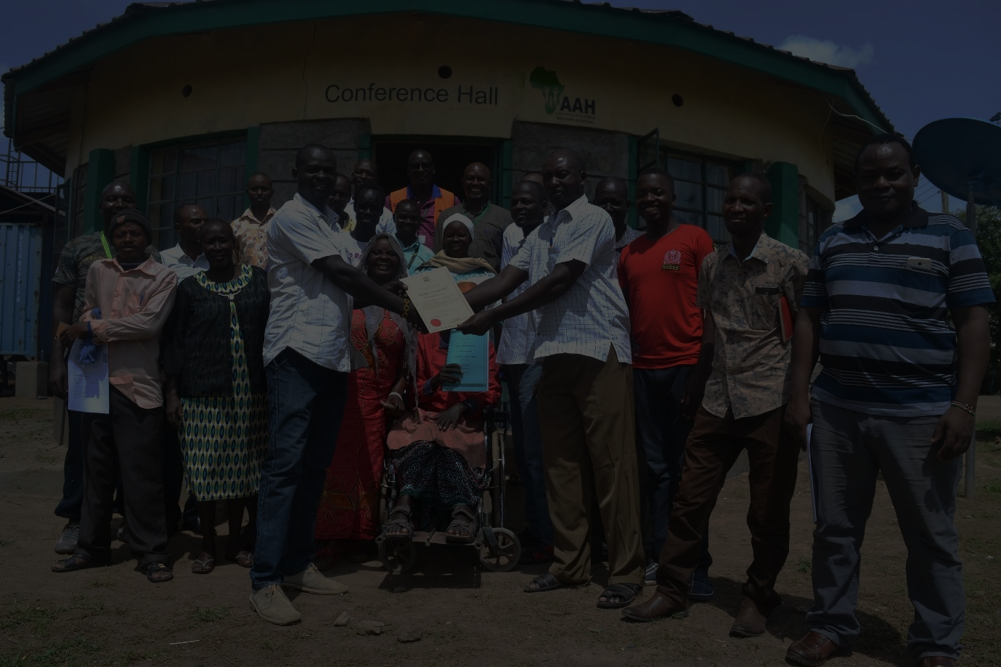
SWOT Analysis
Strengths | Weaknesses | Opportunities | Threats
Strong community relationships | Limited infrastructure | Government support | Environmental challenges
Experience in rural development | Resource scarcity | Natural resources | Political instability
Local partnerships | Security concerns | Youth engagement | Economic fluctuations
The Good Council

Slide 4
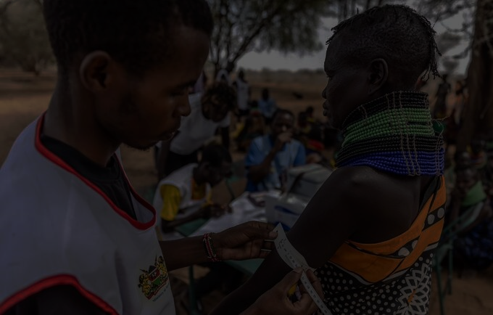
The Cause
Rationale
Address systemic inequalities in education, healthcare, and civic participation to promote sustainable development.
Key Needs
Education
Healthcare
Economy
Civic Engagement
Low enrollment and poor outcomes
Limited access and high disease prevalence.
High unemployment and poverty
Low political participation
The Good Council

Slide 5
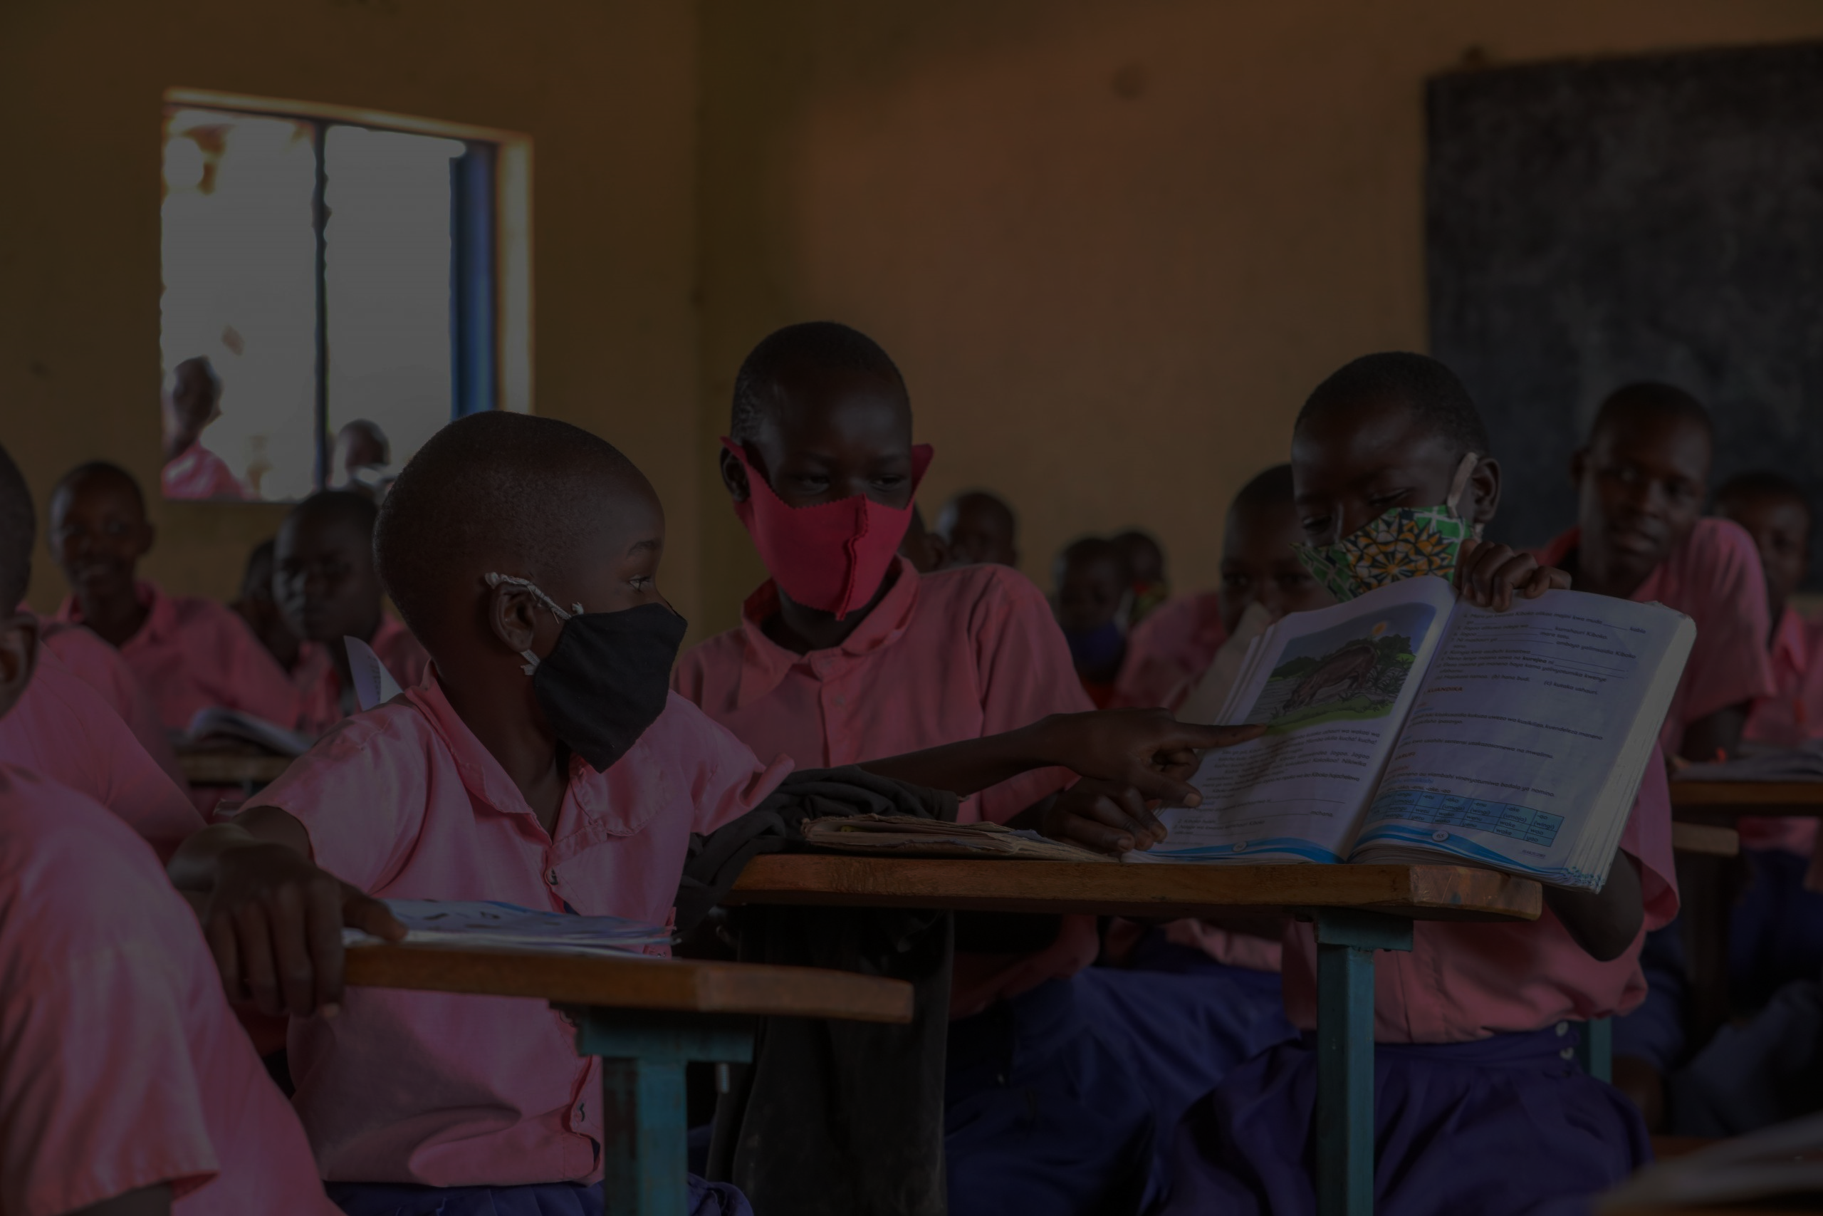



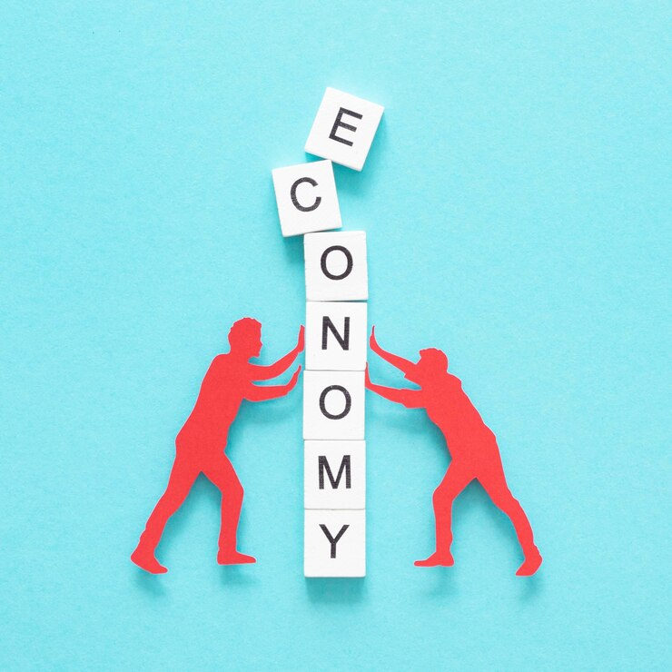
The Action
School infrastructure, scholarships, teacher training
Voter education, youth leadership training, community forums
Mobile clinics, community health workers, sanitation projects
Vocational training, microfinance, livelihood support
The Good Council

Slide 6
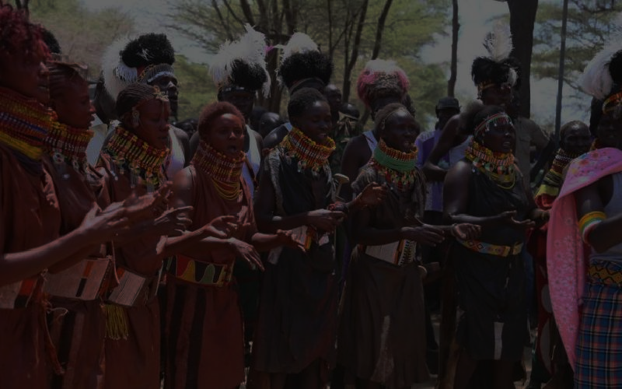

Expected Results
Short Term
Long Term
Improved education and health outcomes
Increased civic participation
Economic upliftment
Social equality and inclusion
Sustainable economic growth
Strengthened democratic governance
The Good Council

Slide 7
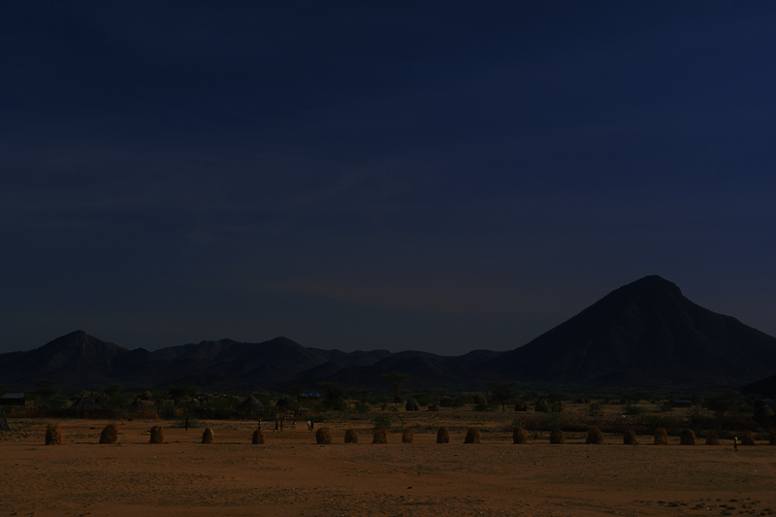

Business Plan
Monitoring
Total Budget
1.000.000€
25.000.000€ over 5 years
Education
Civic Engagement
8.000.000€
5.000.000€
Healthcare
Economy
7.000.000€
4.000.000€
The Good Council

Slide 8
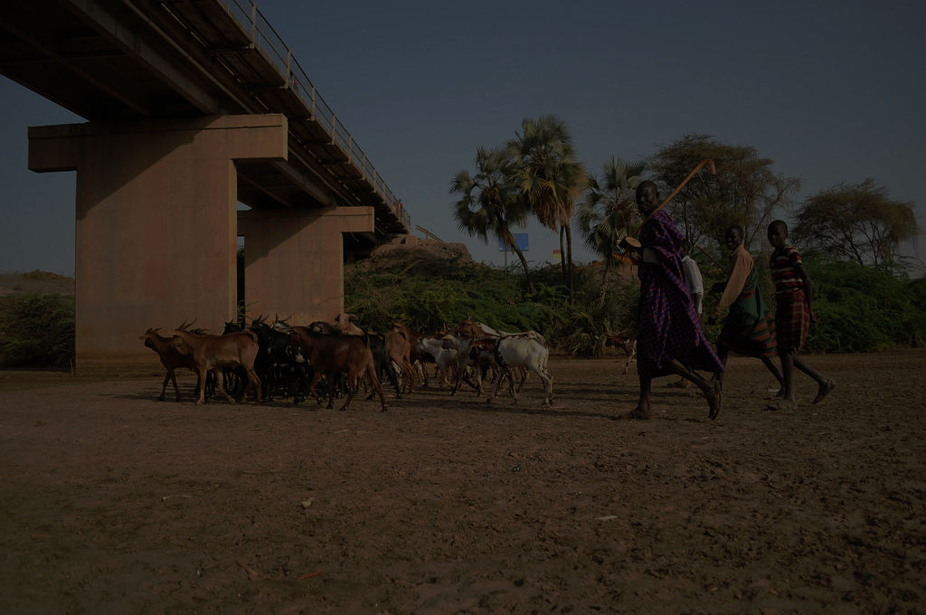
Timeline and Deliverables (1)
1st year
Program initiation and partnership building
2nd year
Program expansion and capacity building
3rd year
Full implementation and mid-term evaluation
The Good Council

Slide 9
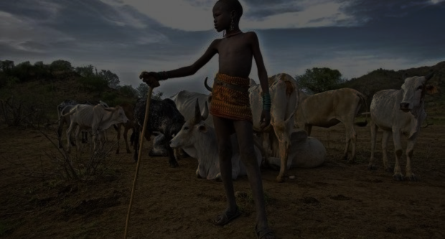
Timeline and Deliverables (2)
4th year
Scaling up and sustainability planning
5th year
Final evaluation and transition to community ownership.
The Good Council

Slide 10
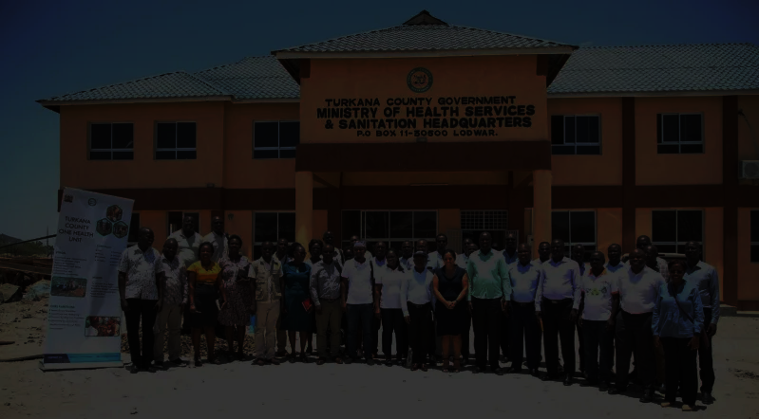
Thank you for your time!
Join us in making this vision a reality for the people of Turkana
The Good Council

Slide 11
Image sources
https://www.freepik.com/
https://encrypted-tbn1.gstatic.com/images?q=tbn:ANd9GcQHCzeetdWjKWqlXoCFS6ayiEMPINcmYviIJEGQLBGGTYJUJo7p
https://opencounty.org/images/background/Turkana_Gen.jpg
https://www.actionafricahelp.org/wp-content/uploads/2018/04/Turkana-county-commissioner-of-cooperatives-handing-over-registration-to-TWISSACO-chairperson-Thomas-Echapan.jpg
https://hapakenya.com/wp-content/uploads/2021/03/turkana-scaled.jpg
https://cdn.standardmedia.co.ke/images/tuesday/lcxctcbufovibu5d52f260a6c10.jpg
https://pre-webunwto.s3.eu-west-1.amazonaws.com/2020-09/dreamstime_s_11067624.jpg
https://live.staticflickr.com/4383/36568971441_86e34167c6_b.jpg
https://media.licdn.com/dms/image/C4D12AQHYg_73r9ZZnA/article-cover_image-shrink_600_2000/0/1520078617623?e=2147483647&v=beta&t=Gu6WbrhesA660RhZGJyMd9vOWVjkrZyCTKC8iXf-Qhs
https://i0.wp.com/turkana.go.ke/wp-content/uploads/2024/03/WhatsApp-Image-2024-03-13-at-1.21.54-PM-e1710328653420.jpeg?fit=800%2C442&ssl=1
https://images.nationalgeographic.org/image/upload/t_edhub_resource_key_image/v1638889552/EducationHub/photos/community-workshop.jpg

